Slide 1
Software product management Product process: Identify opportunity
Nandagopal Govindan

Slide 2
Contents
Overview of product process
Identifying opportunity

Slide 3
Overview of product process
Identify opportunity
Assess the opportunity
Create business plan
Specify product features
Specify Minimum Viable Product (MVP) feature set
Test your MVP
Iterate & Pivot to improve product-market fit

Slide 4
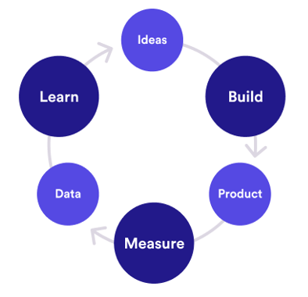

Build-Measure-Learn cycle
Customer interviews
Root cause analysis
Agile
Continuous integration
Minimize total time through the loop
# Visits, conversion, retention
How many use new feature?

Slide 5
Identify opportunity
Identify underserved customer needs (LPP)
Sources of innovation (Peter Drucker)
Hack days (Inspired)
Ideation techniques (Cooper & Edgett) (SPM book)
Case study: DBS Bank
Case study: Innovation ideas from ID Foods - Mustafa

Slide 6
Identifying underserved needs
Observe
Experience
Fortune at the bottom of the Pyramid – CK Prahlad
Desire to do social good can find new opportunities

Slide 7
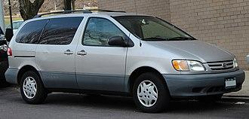
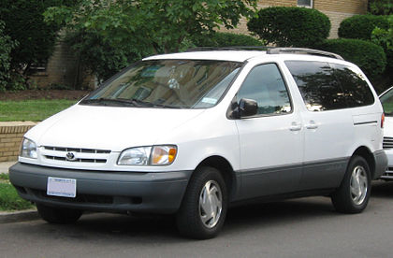
Observe
Toyota Sienna
The car was successful in Japan
Toyota wanted to understand the specific needs of US market
A senior manager spent several months driving 70,000 miles across length & breadth of US observing how people use cars
In US children sit in the backside of the mini van
So changes were made to make the back seats more comfortable, safe, etc.
When it was launched the car became a big hit

Slide 8
Observe
Oyo: Economy hotels were not clean, lacked basic amenities, etc.
Sketch: Observed that Photoshop was not easy to use
Slack: Collaboration between teams was clumsy
Spotify: People wanted to listen to music legally when illegal music sharing sites were banned

Slide 9
Experience
Ola cabs: Founder was travelling in a cab and cab driver demanded exorbitant amount to change the destination
DropBox: Founder kept forgetting to carry files in pen drive
Tally: Experienced that existing accounting packages had a User interface that catered to accounts / finance professional. But not to non-finance folks

Slide 10


Opportunities are in plenty at the bottom of the Pyramid
Opportunities are aplenty if look at the right market
CK Prahlad wrote a book ‘Fortune at the bottom of the Pyramid’
Large business tend to target the middle class and upper middle class
However there is a huge market at the bottom of the pyramid of society
They need products but can not afford high price
If the products are priced right, there is a big opportunity
Examples:
Shampoo sachet for Re.1
Micro credits to rural people to buy a sewing machine, a cow to start milk business, etc. It was observed that default by rural people is significantly less compared to urban people because of the fear of o
Jio, Nirma are other examples of targeting the bottom of the pyramid

Slide 11
Desire to do social good can find new opportunities
(Social entrepreneurship)
Grameen Bank: Mohammad Yunus helped poor to stand on their own legs through micro-businesses
Aravind Eye Hospitals: Free eye surgery for poor, funded by rich patients, developing low cost intraocular lenses
Narayana Hrudalaya: Dr Devi Shetty offeres low-priced heart surgeries by employing efficient operation procedures, low cost insurance schemes
Selco: Dr. Harish Hande developed solar lamps to helps silk farmers harvest mulberry leaves which needs to be done during cooler hours – late evening or early morining
Rivigo: Helped truck drivers lead a stigma free life through relay based truck logistics
Apna: Developed an app for finding blue collar jobs such as delivery boys

Slide 12

Case study: Qalara
What was the opportunity identified by Qalara?
How did Qalara identify the opportunity?

Slide 13
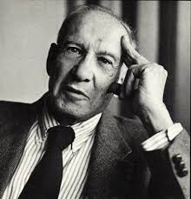

Sources of Innovation: Peter Drucker
Father of management
&
A Social scientist

Slide 14
Sources of Innovation: Peter Drucker
Drucker argues that most innovative business ideas come from methodically analyzing seven areas of opportunity
Some of which lie within particular companies or industries
Some of which lie in broader social or demographic trends.
Astute managers will ensure that their organizations maintain a clear focus on all seven

Slide 15
Sources of innovation: Peter Drucker
Unexpected occurrence
Incongruities (incompatibilities)
Process needs
Industry & market changes
Demographic changes
Change in perception
New knowledge

Slide 16
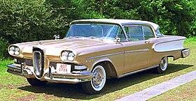
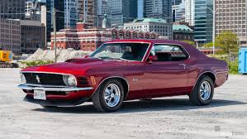
Sources of innovation: Peter Drucker
Unexpected occurrence
IBM developed accounting machines in 1930s. Banks did not have money to buy. But libraries had money and they bought 100 machines
Ford Edsel was very carefully designed. But people bought cars for lifestyle. This resulted in newer models like Mustang

Slide 17
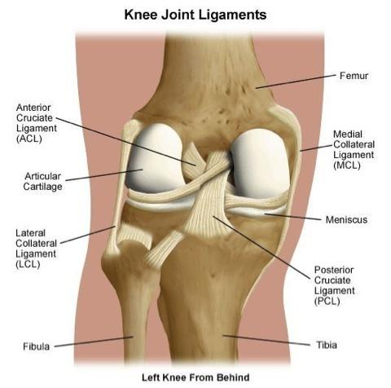
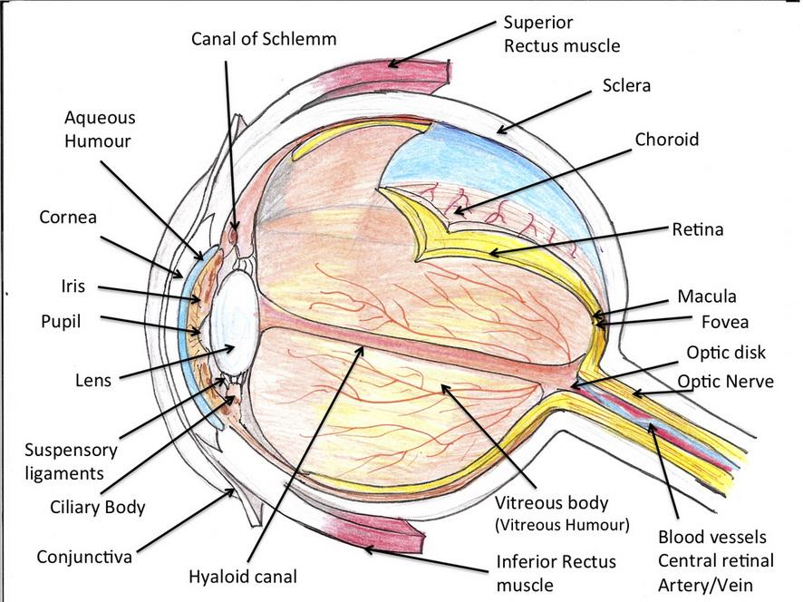
Sources of innovation: Peter Drucker
Incongruities (incompatibilities)
Cataract operation: Cutting eye ligament is difficult. Instead used enzyme to dissolve ligament

Slide 18

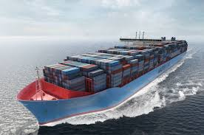
Sources of innovation: Peter Drucker
Incongruities (incompatibilities)
Shipping industry trying to improve speed and fuel efficiency. But problem was time wasted at ports to load & unload. Adopted containers used in railroad and trucks

Slide 19
Sources of innovation: Peter Drucker
Process needs
Newspapers needed a faster way to print. This resulted in Linotype machine
Those days newspapers did not make much money. So they invented advertisements and kept the cost to customer low
Industry & market changes
Retail industry changes: E-Commerce
Banking changes: Payment banks

Slide 20
Sources of innovation…
Demographic changes
1970s saw baby bust and education explosion. This led to shortage of workers. Japan created Robots
Affluent educated young people wanted a different kind of holiday. This led to resort business
Change in perception
In spite of fall in mortality rates, Americans were concerned about cancer, heart disease, etc. This led to health mags, gym, healthy foods
New knowledge
Computers
Etc.

Slide 21
Principles of Innovation – Peter Drucker
Go out, look, ask, listen, because innovation is conceptual & perceptual
Keep innovation simple and focused. Else people get confused
Start small: Example putting the same number of match sticks into a matchbox (it used to be 50), gave Swedes a world monopoly for half a century
Aim at leadership from the beginning, else it is unlikely to be innovative enough
Innovation requires knowledge, ingenuity, and, above all else, focus. Edison worked in electric field only. Citibank did not venture into health care
If diligence (careful), persistence, and commitment are lacking, talent, ingenuity, and knowledge are of no avail. Like in any other endeavour

Slide 22
Identify opportunities…
Annual Idea generation by Bill Gates
2 weeks shut out from world
Go through ideas submitted by employees
Hack days (Inspired)
Hack days – directed and undirected.
Eg of directed hack day with a theme – reduce customer churn, increase life time value (Inspired)

Slide 23
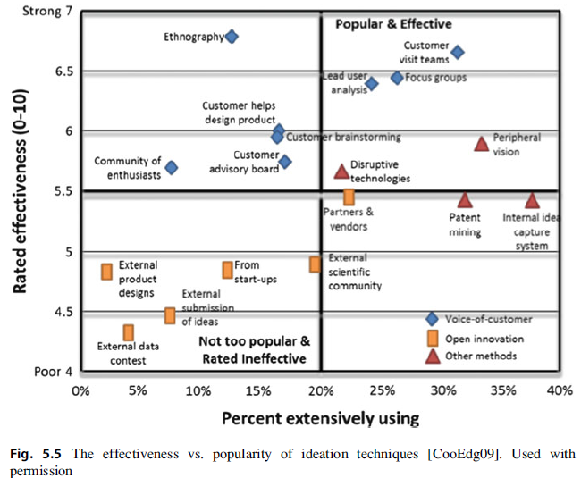
Ideation techniques (Cooper & Edgett)

Slide 24
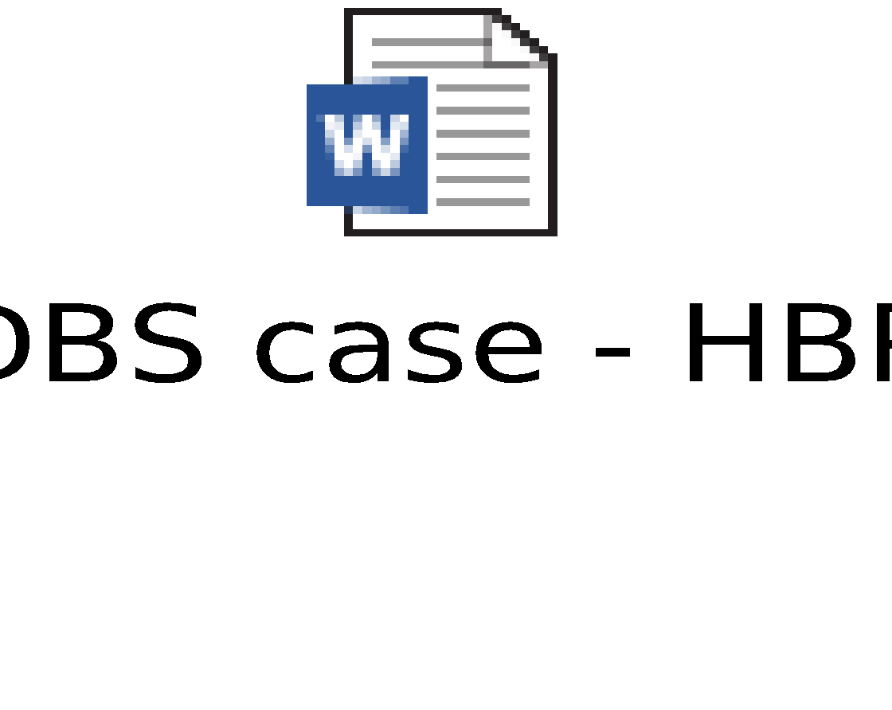
Case study: DBS
Are you really innovating around customer needs? – HBR
What is the assumed need & real need of the customer of DBS?
How did DBS satisfy that need?

Slide 25

Case study: ID Fresh Foods
Innovation ideas from ID Fresh Foods – PC Musthafa
What innovation lessons can we learn from ID Fresh Foods?
Fresh & preservative free is possible
Packaging innovation – Vada
Marketing innovation: Trust shops

Slide 26
Exercise
Consider your current job & company
Think about the unmet / underserved needs of your customers
Give one example of such a need & its compelling value / benefit to customer.

Slide 27
Appendix

Slide 28
